Slide 1
SQL JOINS by Venkat K.

Slide 2
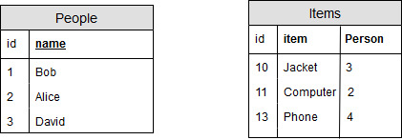
GOAL: Want to get a table with people and the items they own

Slide 3
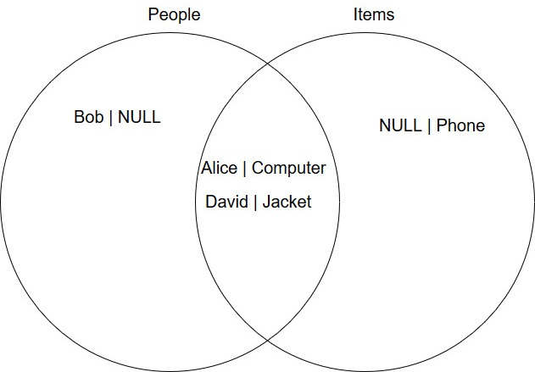
SELECT P.name, I.item
FROM People AS P INNER JOIN Items AS I ON P.id = I.Person

Slide 4
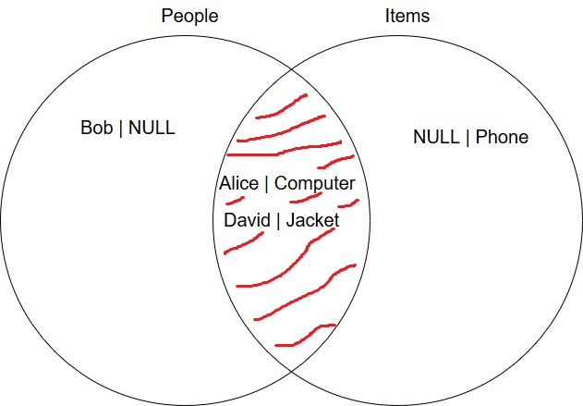
SELECT P.name, I.item
FROM People AS P INNER JOIN Items AS I
ON P.id = I.Person

Slide 5
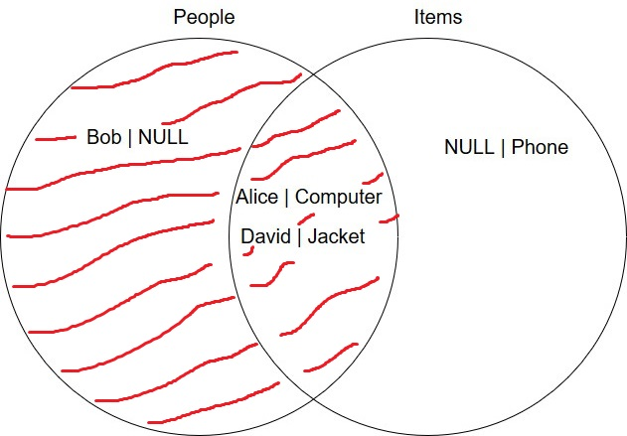
SELECT P.name, I.item
FROM People AS P LEFT JOIN Items AS I
ON P.id = I.Person

Slide 6
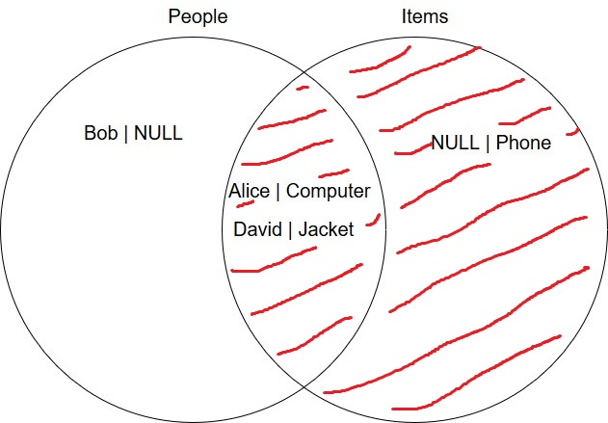
SELECT P.name, I.item
FROM People AS P RIGHT JOIN Items AS I
ON P.id = I.Person

Slide 7

Source: https://www.codeproject.com/Articles/33052/Visual-Representation-of-SQL-Joins

